Slide 1

Differences Between Word 2003 to 2007
Word
2007
Word
2003
Purdue University Calumet
Word 03-07

Slide 2
What You Will Learn
New Vocabulary & Terms
New Visual Layout
Differences from previous version
Word 03-07

Slide 3
Understanding The Connection
Word 2007- Putting the pieces together
Ribbon
Quick Access
Groups
Commands
Tabs
Word 2007
Mini Toolbar
Highlighted
Information
Office button

Slide 4
Vocabulary
Ribbon
Office Logo Button
Tabs
Groups
Commands
Quick Access Toolbar
Mini Toolbar
Word 03-07

Slide 5
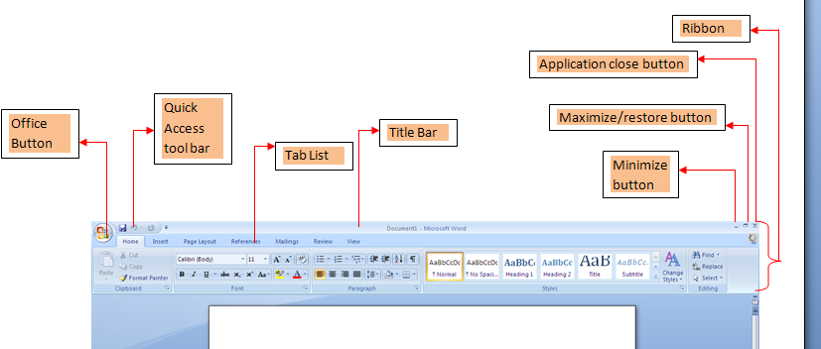
The New Word Screen Layout
PowerPoint 03-07
Notes:
Explain that this screen and the next screen are halves of the same screen.

Slide 6
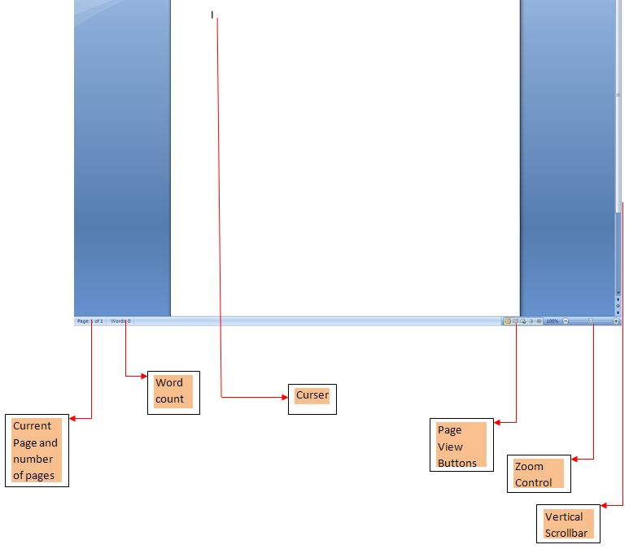
Screen Layout Continued
PowerPoint 03-07
Notes:
Second half of same screen

Slide 7
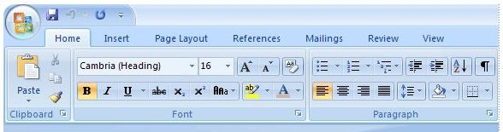
Word 2007
Most of the changes in Word are in what is called the Ribbon, the area that spans the top of Word.
Word 03-07

Slide 8
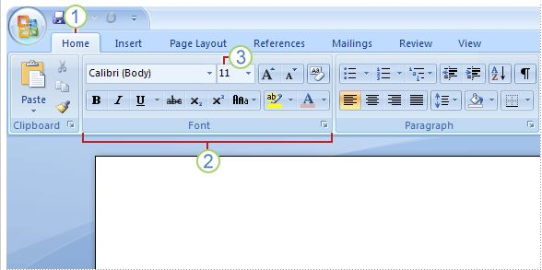
Get More from the Word Ribbon
There are three basic components to the Ribbon:
1) Tabs. 2) Groups, and 3) Commands.
Word 03-07

Slide 9
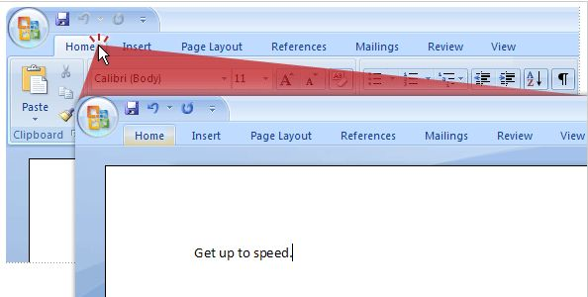
Temporarily hide the Ribbon
Double-click the active tab. The groups disappear, so that you have more room.
Whenever you want to see all of the commands again, double-click the active tab to bring back the groups.
Word 03-07
Notes:
Explain expanded ribbon and shrunken ribbon. Give example out side of powerpoint.

Slide 10

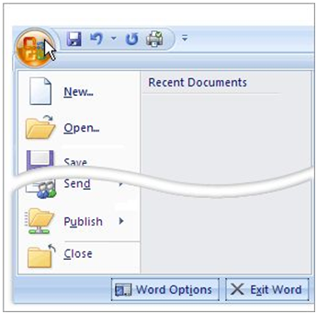
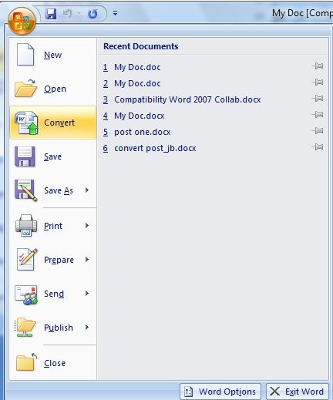
The Office Logo Button
Microsoft Office Button This button is located in the upper-left corner of the Word window and opens the menus shown here.
Word 03-07

Slide 11
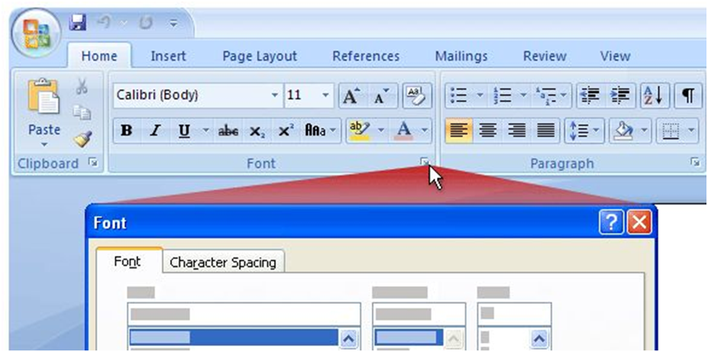
The Dialog box launchers
The arrow is called a Dialog Box Launcher. When you click it, you'll see more options related to that group.
Word 03-07

Slide 12
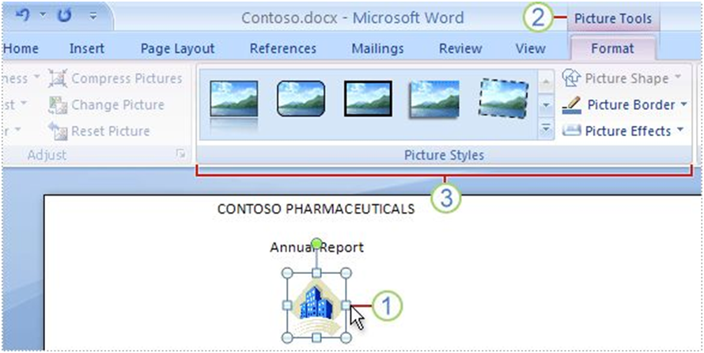
Additional tabs appear when needed
In Word 2007, certain tabs appear only when you need them.
Word 03-07

Slide 13
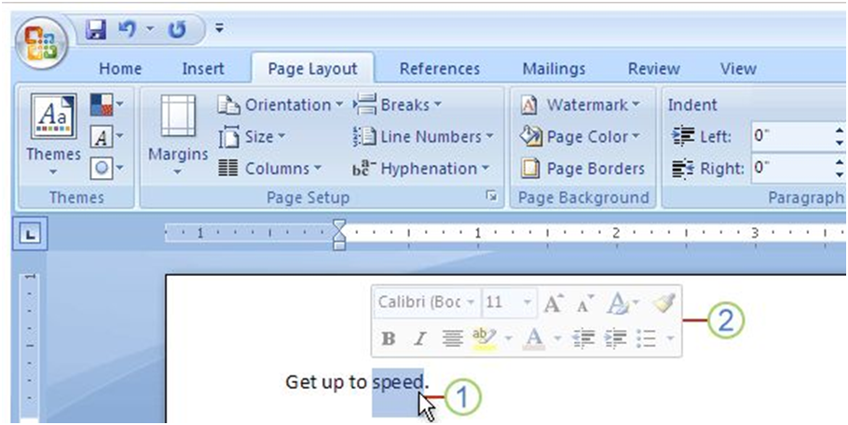
The Mini toolbar
Allows you to have formatting commands available for whenever you select text.
Word 03-07

Slide 14

Add a command to the Quick Access Toolbar
1. On the Ribbon, click the appropriate tab or group to display the command that
you want to add to the Quick Access Toolbar.
2. Right-click the command, and then click Add to Quick Access Toolbar on the
shortcut menu.
Word 03-07

Slide 15
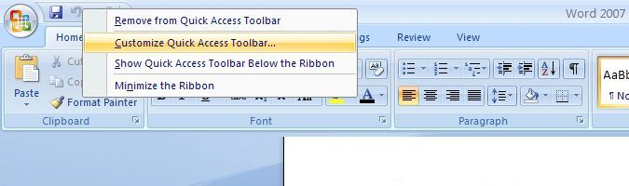
Second Way to Add To Your Quick Access Toolbar
Right-click in the Quick Access Toolbar Area, and then select Customize Quick Access Toolbar.
Word 03-07

Slide 16
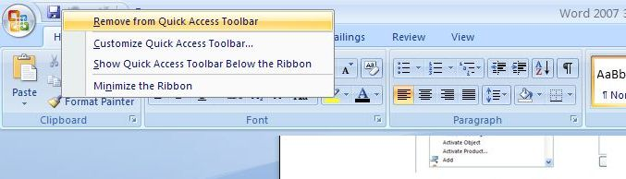
How to Remove Items From the Quick Access Toolbar
Right-click in the Quick Access Toolbar Area, and then select Remove from Quick Access Toolbar.
Word 03-07

Slide 17
Use the keyboard Shortcuts
Shortcuts that start with the CTRL key (for example, CTRL+C for copy, or CTRL+ALT+1 for Heading 1), remain the same as in previous versions of Word.
But the Ribbon design comes with new shortcuts: Key Tips.
Word 03-07

Slide 18
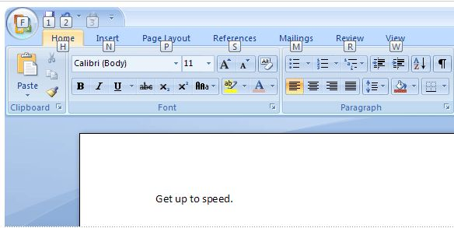
Keyboard Shortcuts continued
Press ALT to make the Key Tip badges appear for all Ribbon tabs, the Quick Access Toolbar commands, and the Microsoft Office Button.
Word 03-07

Slide 19
Overview
Word 2007 putting the pieces together
Ribbon
Tabs
Logo Button
Groups
Word
Quick Access Toolbar
2007
Highlighted Information
Commands
Mini Toolbar
PowerPoint 03-07

Slide 20
Questions
Word 03-07

